Slide 1

Predicting Life Expectancy of cats
EDA and Modelling

Slide 2
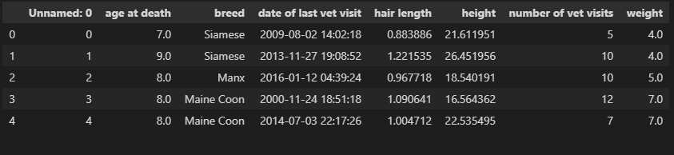
Importing the dataset

Slide 3
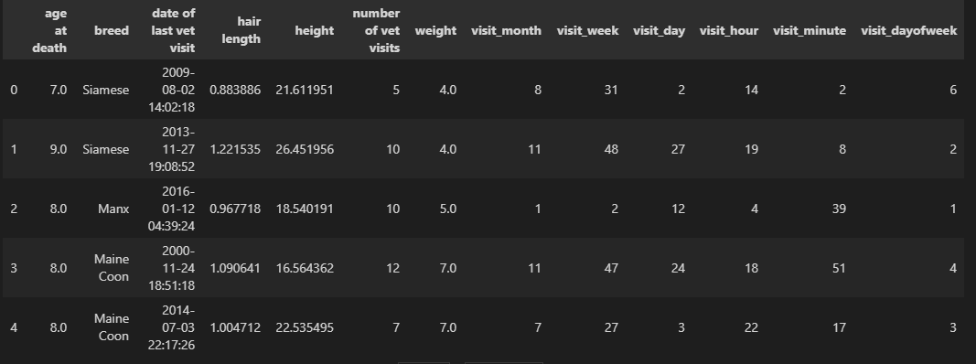
Modified dataset
Date value - 2009-22-12 02:43:43
Datetime format

Slide 4
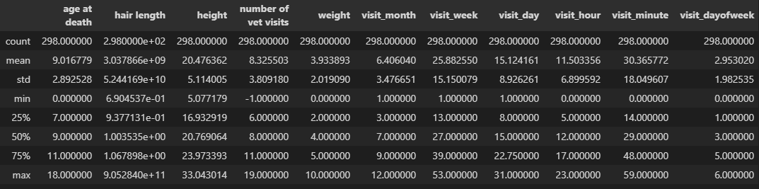
Summary Statistics and sanity checks
Check for null values
11 rows with weight zero
8 rows Number of vet visits -1 or 0
2 rows with age at death 0
Very high hair length value

Slide 5
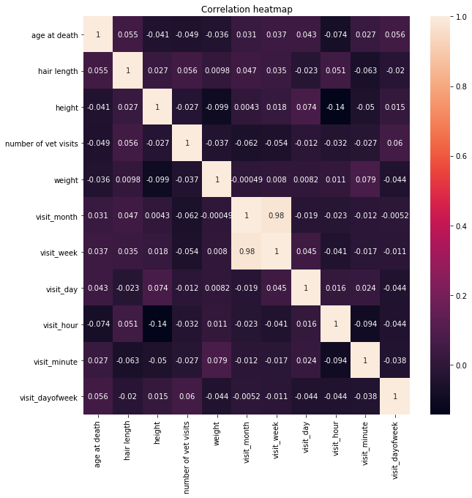
Exploratory Data Analysis

Slide 6
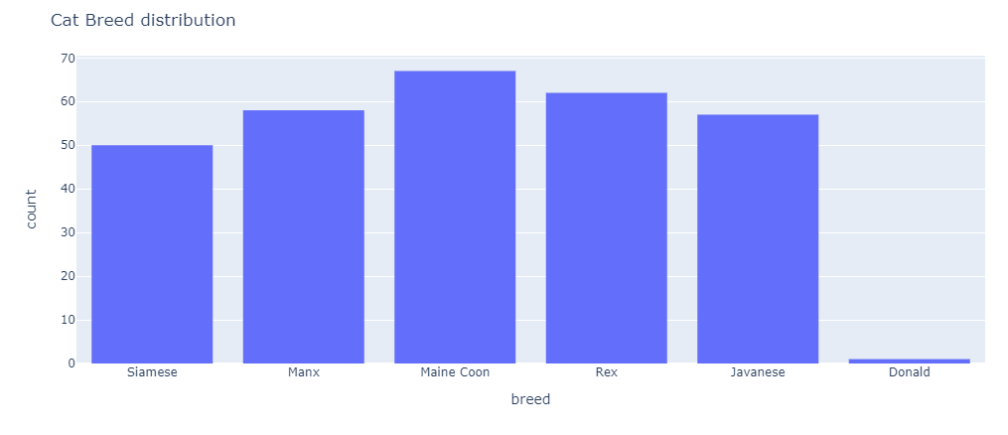
EDA

Slide 7
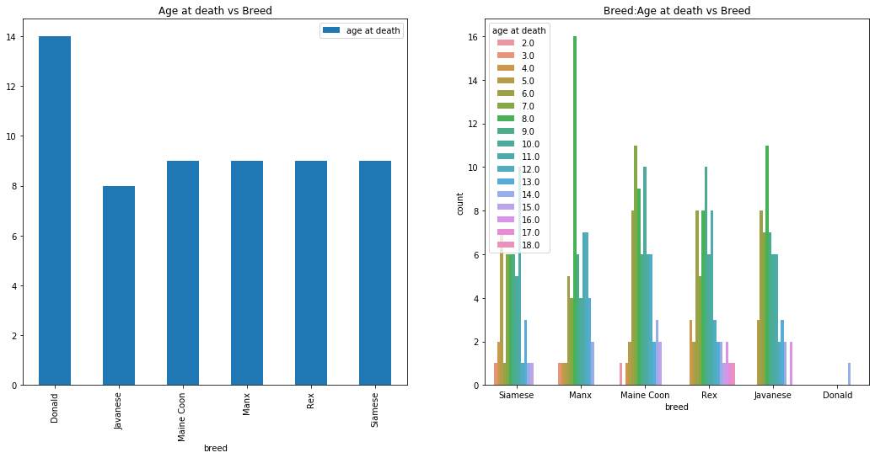
EDA

Slide 8
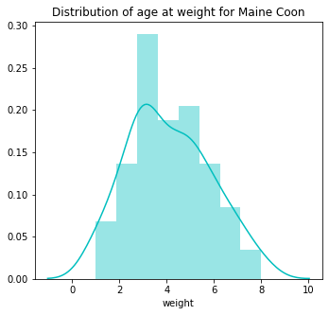
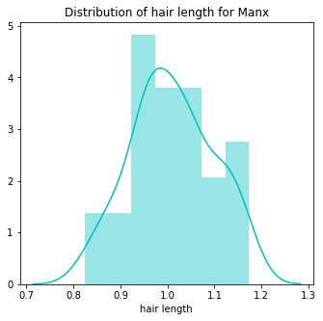
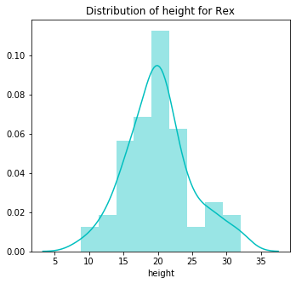
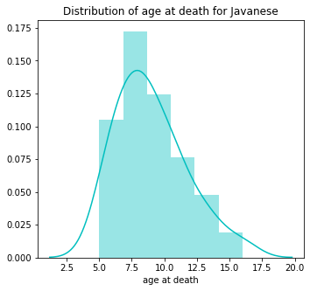
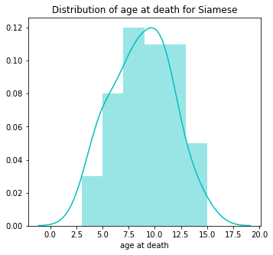
EDA

Slide 9
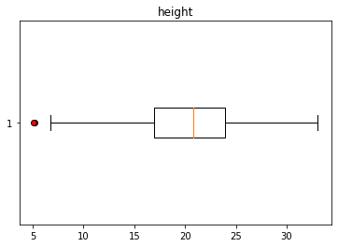
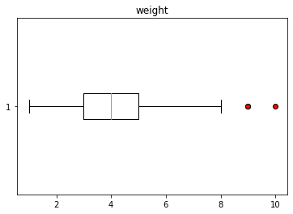
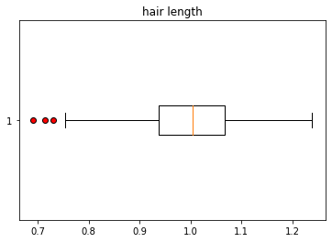
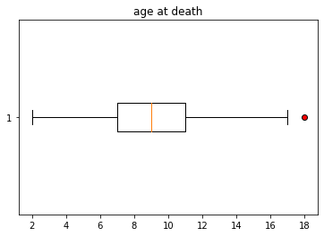
EDA

Slide 10
Findings After EDA
Normally distributed data
Median age at death between 8 and 9
No need for subsampling
No major outliers

Slide 11
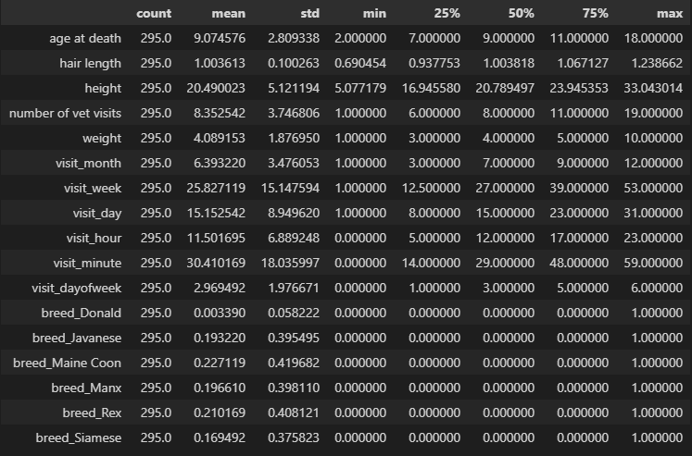
Data Modelling
One hot encoding

Slide 12
Data Modelling
Splitting dataset into Training, Validation and Testing sets.
75%, 20%, 5%
X train shape (224, 16)
Y train shape (224,)
X validation shape (56, 16)
Y validation shape (56,)
X Test shape (15, 16)
Y Test shape (15,)

Slide 13
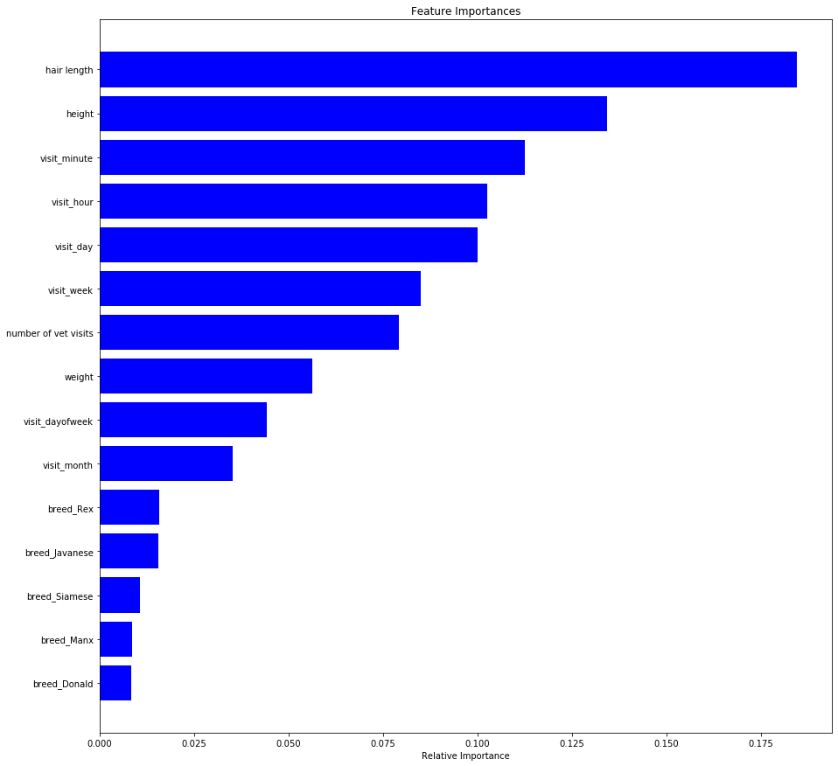
Data Modelling
Feature Importance using Random Forest

Slide 14
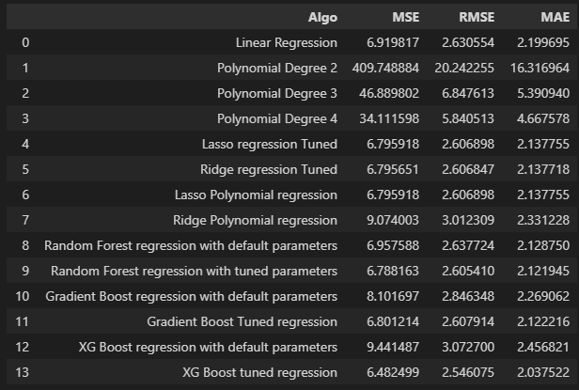
Data Modelling
Best Algorithm: XGBoost with hyperparameter tuning

Slide 15
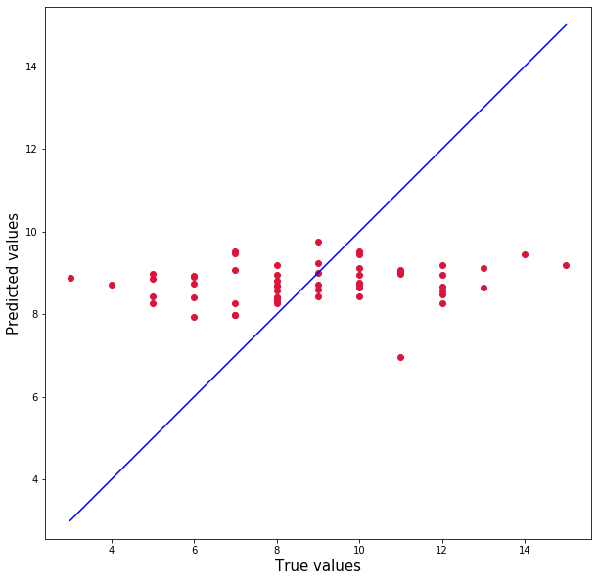
Data Modelling
XG Boost True vs actual plot
MAE – 2.05

Slide 16
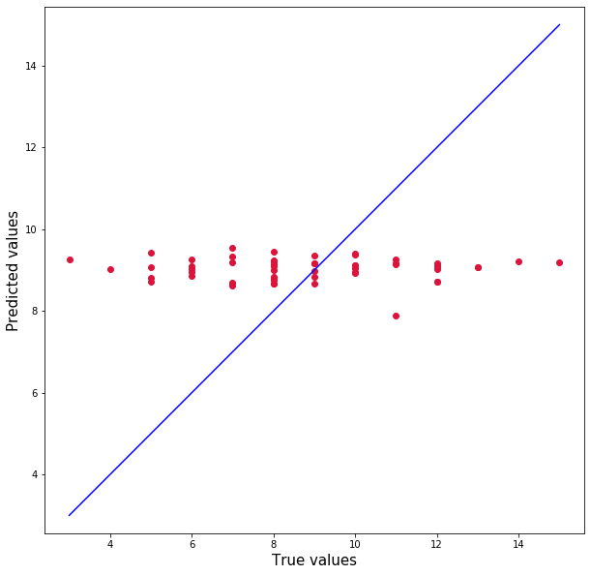
Data Modelling
Gradient Boost True vs actual plot
MAE – 2.12

Slide 17
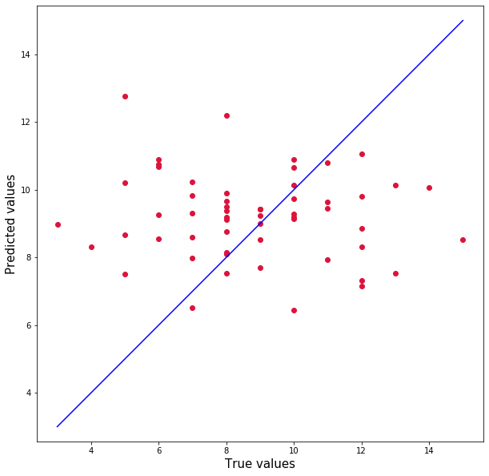
Data Modelling
Ridge Polynomial True vs actual plot
MAE – 2.33

Slide 18
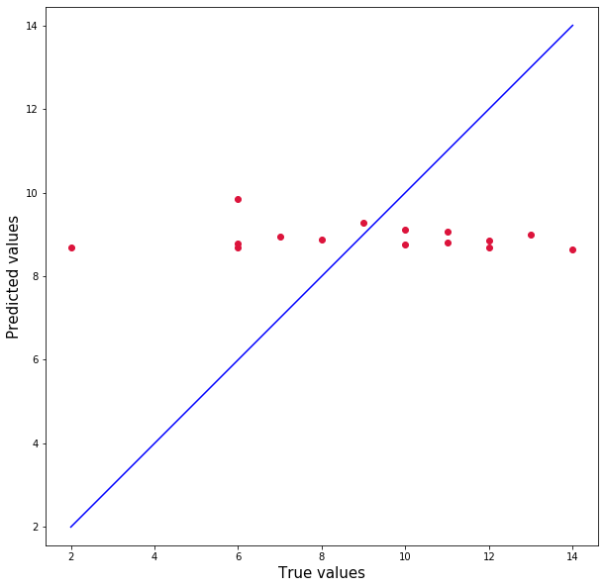
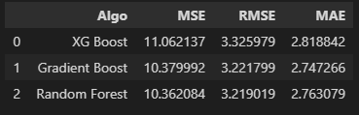
Evaluation on Unseen test data

Slide 19
Conclusion
Models did not perform well
Having some data about the date of death
Adding more data might help

Slide 20

Thankyou

